Slide 1
Optimizing NFL Team Construction Using a Genetic Algorithm
Group 4
Evan Fox, Sumedh Khodke, Dineshkumar Katta, Sanjay Aravind Loganathan Ravichandran, Amritha Subburayan
Notes:
3 Minute Thesis
Motivation
possible outcome
possible data source
initial results if available

Slide 2
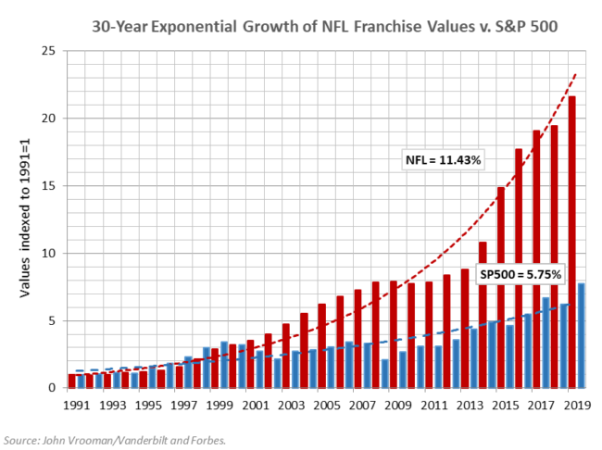
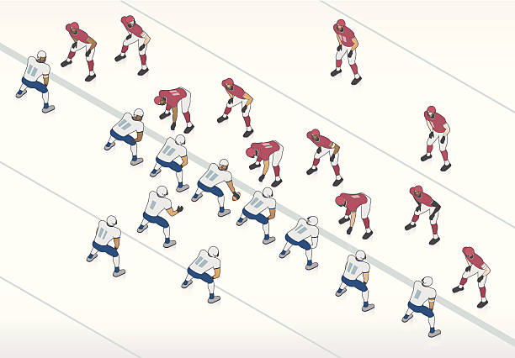
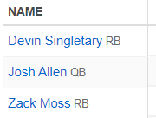
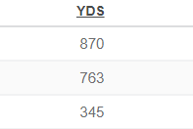
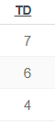
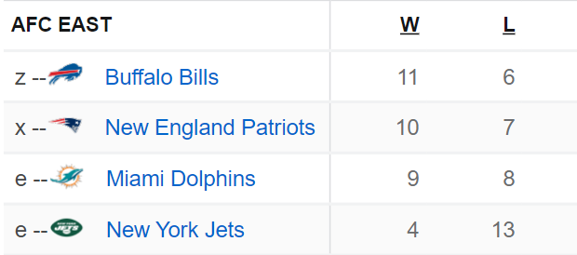


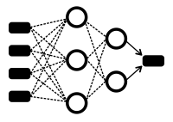



This project’s goal is to design a NFL team construction heuristic using a Genetic Algorithm with a learned fitness function that evaluates a team’s quality. The R Shiny application may explore optimal solutions, cluster player choices to illustrate the algorithm’s roster choices, and/or live-run the algorithm with custom team constraints.
Sports analytics is a new field with abundant opportunities for disruptive innovation.
Evolutionary
Algorithm
Generate Potential Rosters
(Initialize Individuals)
Machine Learning
(Fitness Function)
Inputs:
Roster
Player Statistics
Supervisor - Team Record / ELO / Point Differential
Evaluate Team Quality
(Survival Score / Fitness Function)
Select Best Teams
(“Survival of the fittest”)
Model:
XGBoost
Custom Neural Network
Generate New Rosters (Mutate / Evolve)
92
Output:
Team Quality
Select Best Team

Slide 3
Notes
Abstract - This project’s goal is to design an optimal NFL team construction heuristic using a Genetic Algorithm with a learned fitness function that evaluates a team’s quality. The R Shiny application will focus on exploring optimal solutions, clustering player choices to illustrate the algorithm’s roster choices, and live-running the algorithm with custom team constraints.
How we translate the algorithm to an R Shiny app, mostly depends on it’s speed with different levels of constraint
Motivation - Sports analytics is a new field with opportunities for disruptive innovation. New analytics tools and heuristics for team construction are prime domains for research.
Sports franchises are growing fast – even faster than the S&P500
Location is the biggest factor that influences team value, but success and a good team construction are the next best thing (we can’t change location)
Genetic algorithm, fitness function
When you have 53 players on a roster and thousands of eligible players, the solution space is too large to (~10^150)
One of the key elements in a genetic algorithm is the fitness function – think in evolutionary terms how likely that entity is to survive – in our terms, how good a team is
We hope to use a learned fitness function to best construct a team, without user-input definition of what a “good” team looks like
R shiny app for interactive analysis of
Team roster customization – fixed players + variable suggestion
Understanding algorithm roster suggestion
Using clustering (hopefully understand which players have high value, to the algorithm
Understanding learned model / fitness function
Which features are important
Since this is a lot to do… we’ve constructed a phased development path towards ideal state
Start with a simple fitness function (weighted average between offense and defense) – no ML
Start with Madden player ratings, instead of player statistics
Remove these shortcuts/assumptions as we develop
Planned data sources
Initially, use madden ratings instead of player statistics – but nfl statistics are publicly and readily available, as are historical team records

Slide 4
Sources
https://media.istockphoto.com/vectors/american-football-illustration-vector-id521651665?k=20&m=521651665&s=612x612&w=0&h=_XOh4qp7fssaeLPtJTKkhnXes9cdbgCMrIBIYjuTwlI=

